Slide 1

INSTITUTE-UIE
DEPARTMENT- AU-1 to 5
Bachelor of Engineering (All Branches)
Mathematics-I (23SMT-121)
Matrices & its Applications
DISCOVER . LEARN . EMPOWER

Slide 2

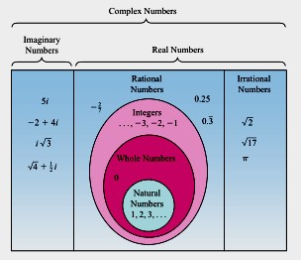
Introduction to Complex Numbers

Slide 3


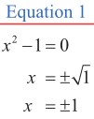

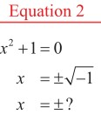
Introduction

Slide 4

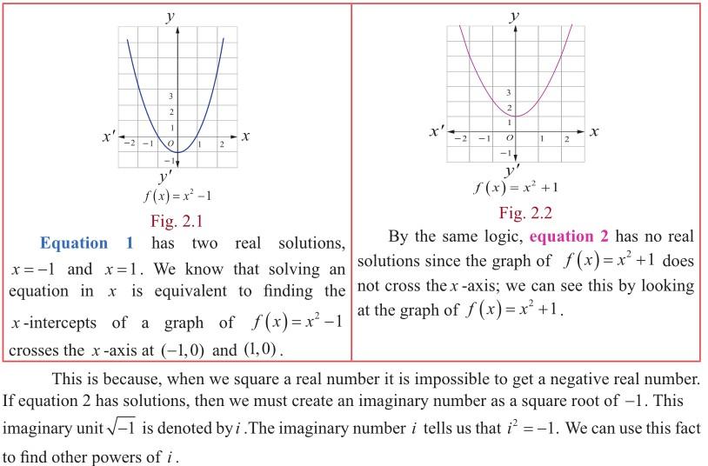

Slide 5



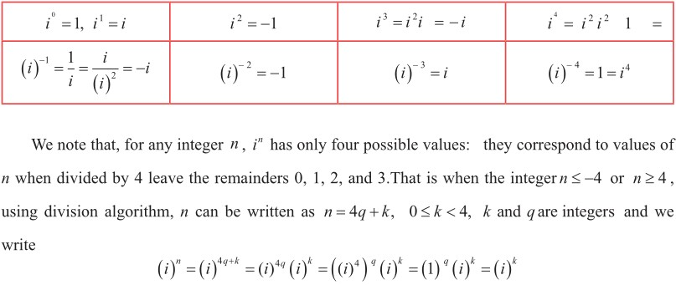

Slide 6



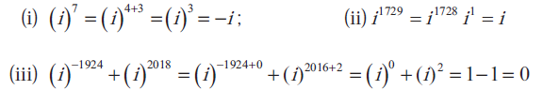
Problem-1
Solution:

Slide 7

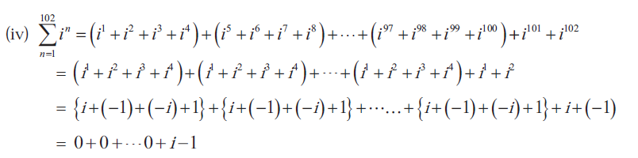




Slide 8

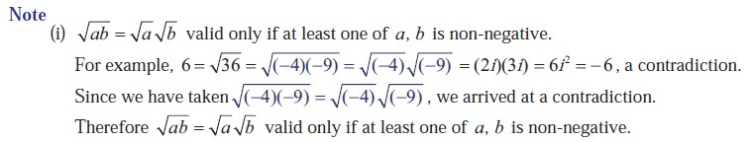

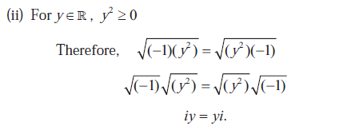

Slide 9
Definition: Rectangular form of a Complex Number

Slide 10

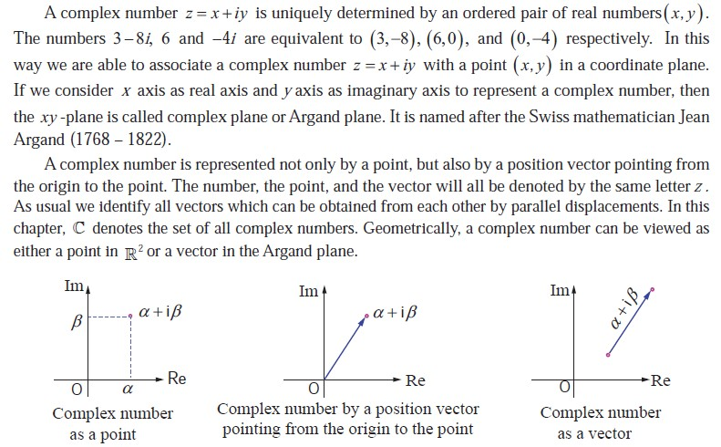
Argand Plane

Slide 11



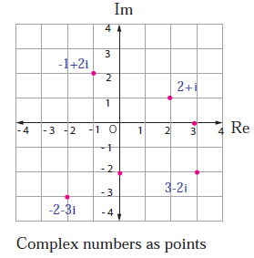
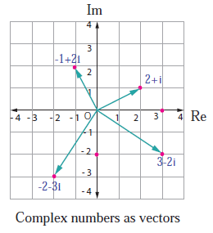
Illustration:

Slide 12



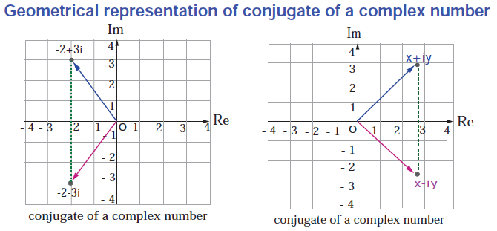
Definition: Conjugate of a Complex Number

Slide 13

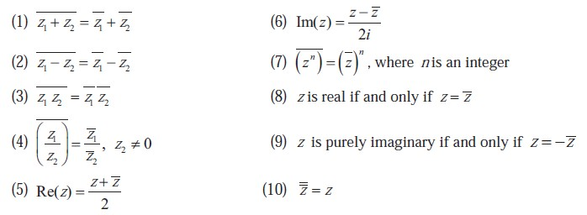
Properties of Complex Conjugates

Slide 14



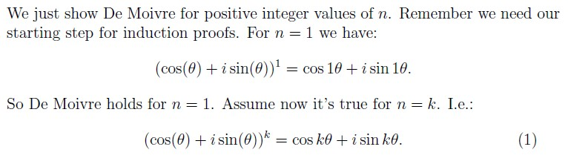
2.De-Moivre’s Theorem
Statement:
Proof:

Slide 15

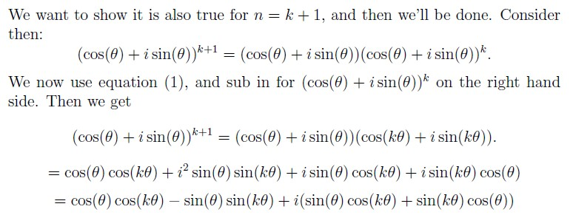

Conclusion:
Hence by the principle of Mathematical Induction we’ve
shown that De Moivre’s to be true for all positive integers n.

Slide 16


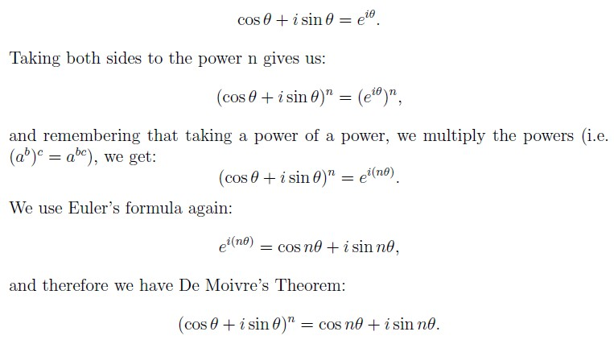

Slide 17

Remark:
De-Moivre’s theorem can be shown true when n is a negative integer and even n is a rational number.
Corollary:

Slide 18


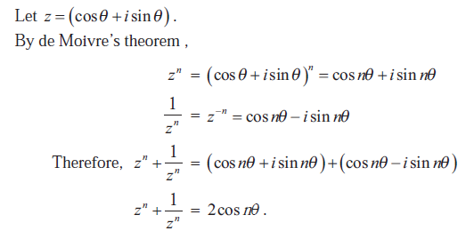
PROBLEM-1
Solution:

Slide 19

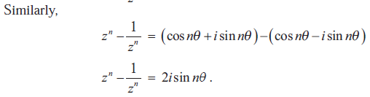

Slide 20



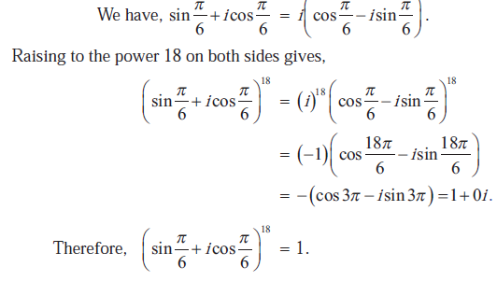
PROBLEM-2
Solution:

Slide 21




PROBLEM-3
Solution:

Slide 22

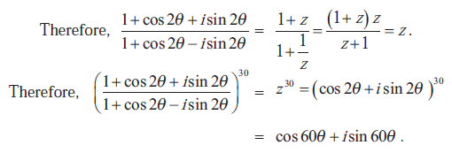

Slide 23



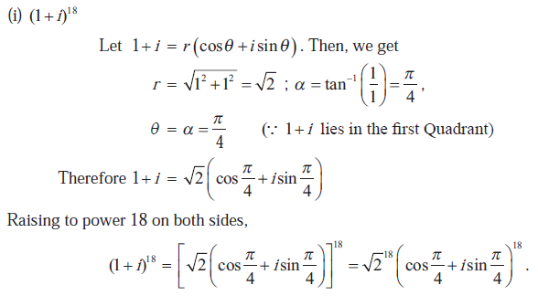
PROBLEM-4
Solution:

Slide 24

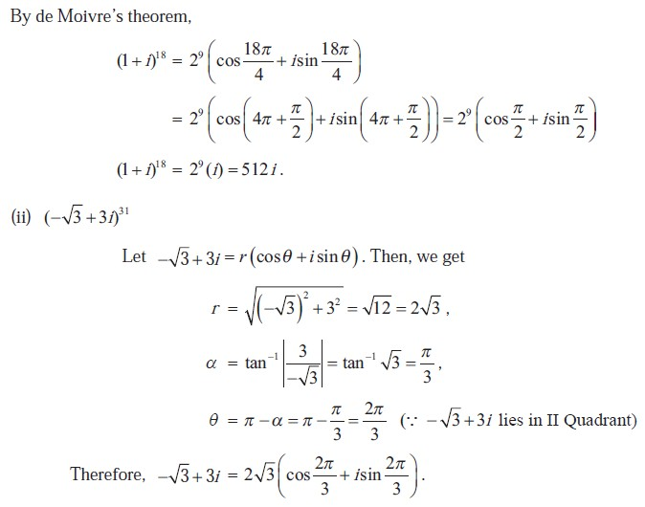

Slide 25

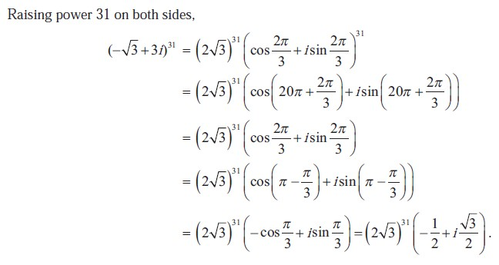

Slide 26


PROBLEM-5

Slide 27

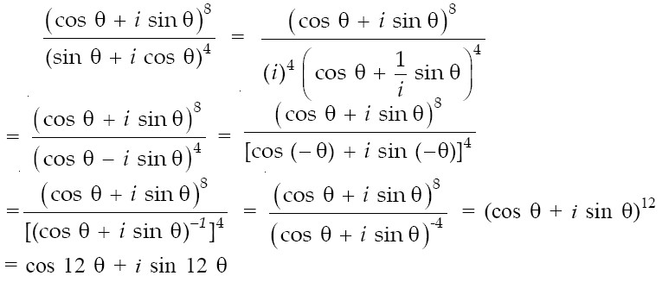
Solution:

Slide 28

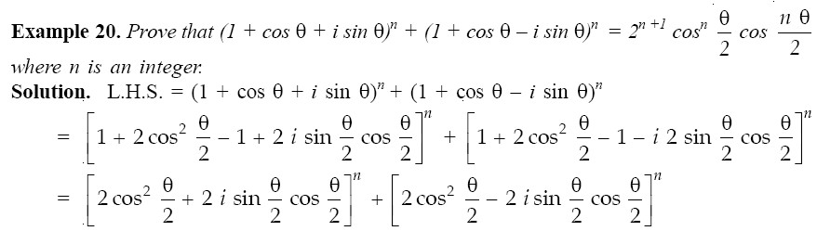

PROBLEM-6

Slide 29

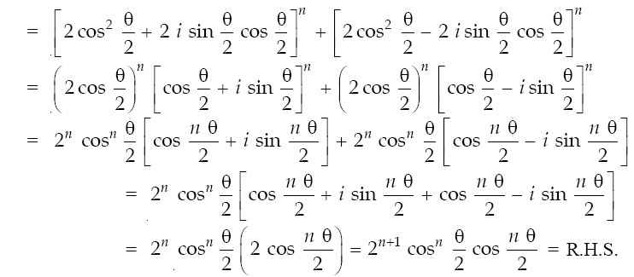

Slide 30


PROBLEM-7

Slide 31

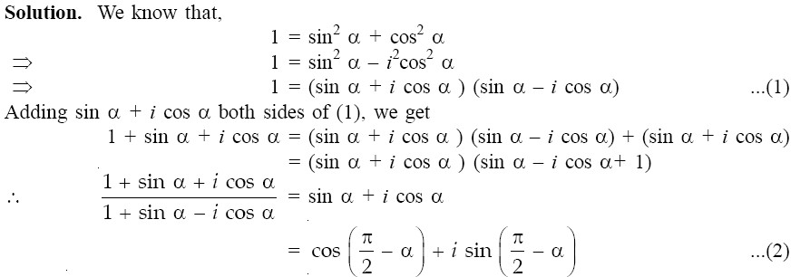

Slide 32

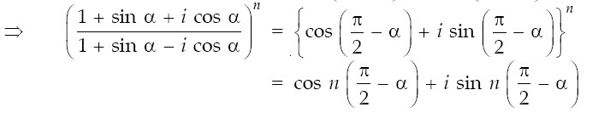

Slide 33

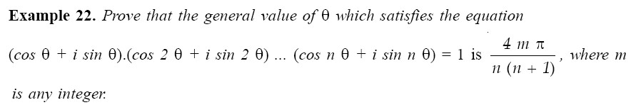
PROBLEM-8

Slide 34

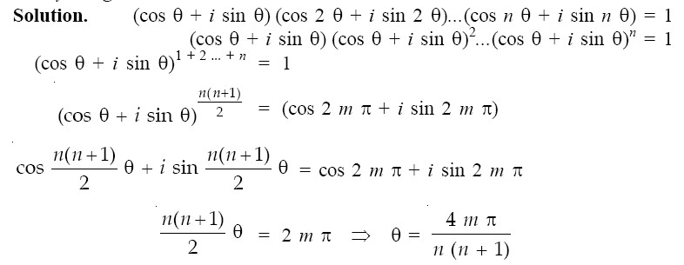

Slide 35


3. Real and Imaginary Parts of Exponential Function
1

Slide 36

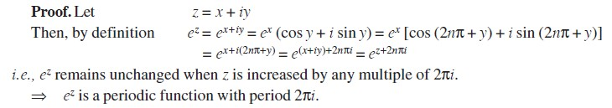
Theorem
2

Slide 37





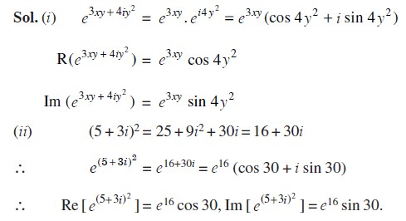
PROBLEM: Split up into real and imaginary parts
3

Slide 38

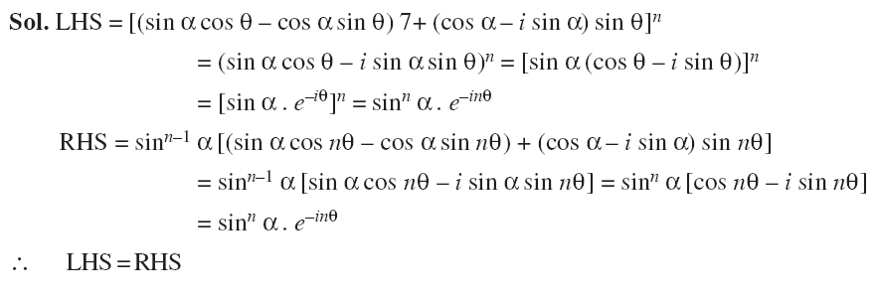
PROBLEM
4

Slide 39


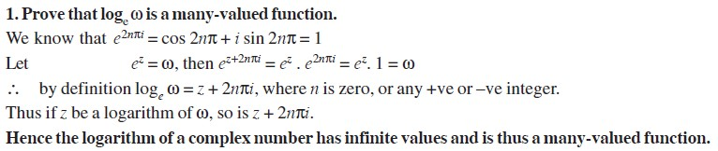
4. Logarithmic Functions

Slide 40

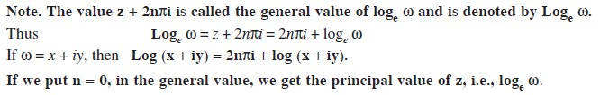



Slide 41

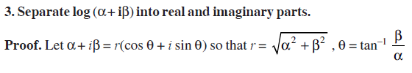

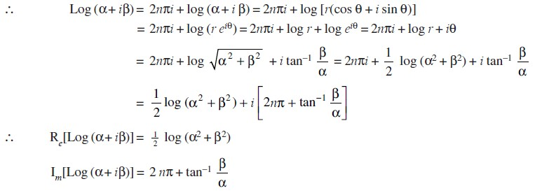


Slide 42

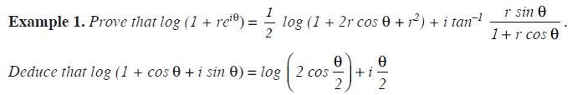

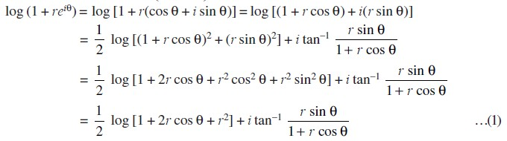
Solution:

Slide 43

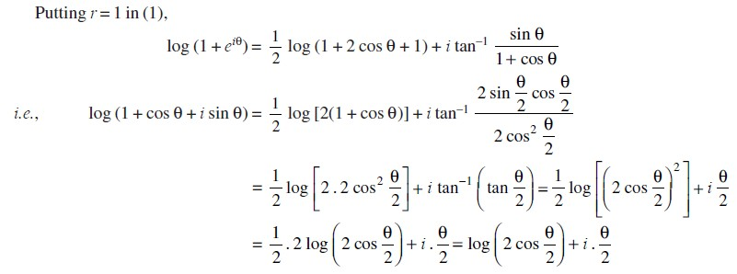

Slide 44

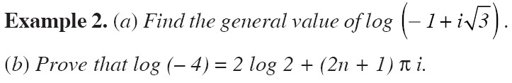

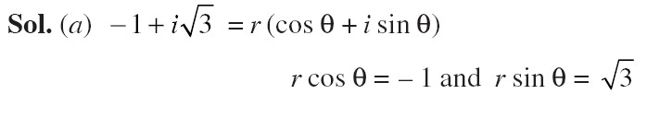

Slide 45

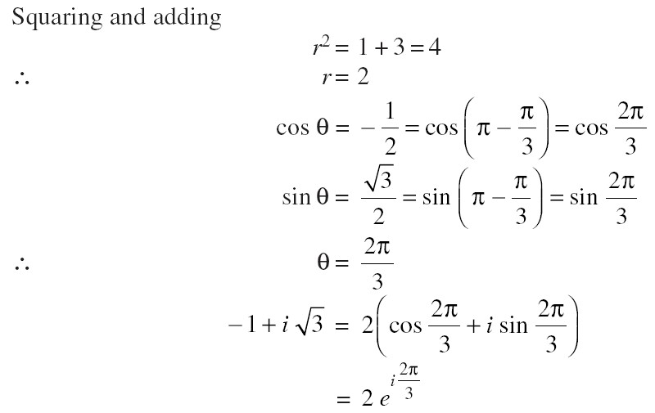

Slide 46

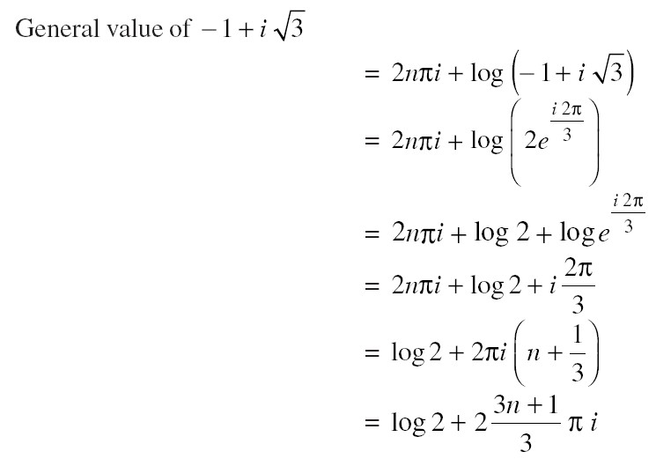

Slide 47

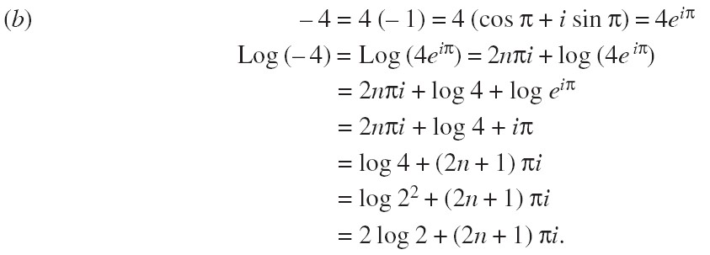

Slide 48

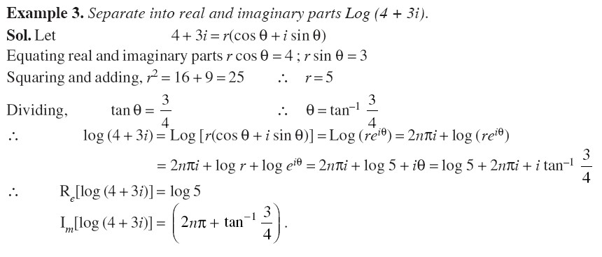

Slide 49

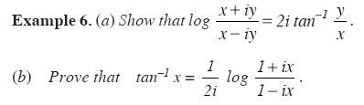

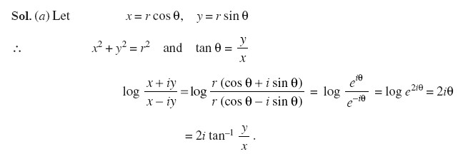

Slide 50

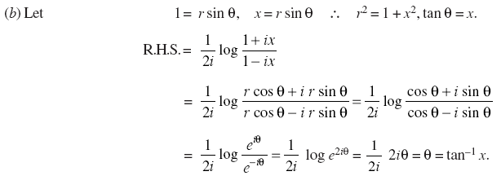

Slide 51




Problem:
13

Slide 52




Problem:

Slide 53



Slide 54




Definition: General exponential function

Slide 55





Problem:

Slide 56



Slide 57




Problem:

Slide 58



Slide 59




Problem:

Slide 60



Slide 61




5. Circular Functions of a Complex Number

Slide 62



Slide 63


Euler’s Theorem

Slide 64


Periodicity of Circular Functions

Slide 65



Slide 66


Trigonometrical formulae for complex quantities

Slide 67





Slide 68



Slide 69



Slide 70



Slide 71



Slide 72




Problem:

Slide 73



Slide 74





Problem:

Slide 75




Problem:

Slide 76



Slide 77



Slide 78



Slide 79


Problem:

Slide 80



Slide 81



Slide 82



Slide 83


Problem:

Slide 84




Problem:

Slide 85





Slide 86




Problem:

Slide 87



Slide 89




6. Hyperbolic Functions
1

Slide 90


2

Slide 91


3

Slide 92


RELATIONS BETWEEN HYPERBOLIC AND CIRCULAR FUNCTIONS
4

Slide 93


5

Slide 94


PROVE THAT HYPERBOLIC FUNCTIONS ARE PERIODIC AND FIND THEIR PERIODS
6

Slide 95



7

Slide 96



8

Slide 97

9

Slide 98


FORMULA FOR HYPERBOLIC FUNCTIONS
10

Slide 99


11

Slide 100


12

Slide 101


13

Slide 102


14

Slide 103


15

Slide 104



16

Slide 105


17

Slide 106


18

Slide 107


19

Slide 108


20

Slide 109


21

Slide 110


22

Slide 111



23

Slide 112


24

Slide 113



25

Slide 114


26

Slide 115


27

Slide 116



28

Slide 117




29

Slide 118



30

Slide 119




31

Slide 120


32

Slide 121
33

Slide 122


7. Inverse Functions
7.1 Inverse Trigonometrical Functions

Slide 123



Slide 124





Slide 125


7.2 Inverse Hyperbolic Functions

Slide 126



Slide 127



Slide 128



Slide 129



Slide 130





Problem:

Slide 131



Slide 132



Slide 133



Slide 134



Problem:
13

Slide 135
14

Slide 136


8. Summation of Trigonometric Series

Slide 137



Slide 138



Slide 139



Slide 140



Slide 141



Slide 142



Slide 143



Slide 144



Slide 145



Slide 146



Slide 147



Slide 148



Slide 149



Slide 150



Slide 151
Reference Material
Text and Reference Books
Higher Engineering Mathematics by H.K.Daas
Higher Engineering Mathematics by B.S.Grewal
A text book of Engineering Mathematics by N.P. Bali and Manish Goyal
Advanced Engineering Mathematics by E.Kreyszig
Online Video Sites
NPTEL
Unacademy
Coursera

Slide 152
THANK YOU
For queries
Email: shivanibansal.maths@cumail.in

